Slide 1
A Key initiative implemented by Rand Water and customers: Project 1600
Strategy Steering Committee Meeting: 27 February 2018
Department of Water and Sanitation
Presentation by:
Shuntelle Gow
Rand Water
Water Cycle Management

Slide 2
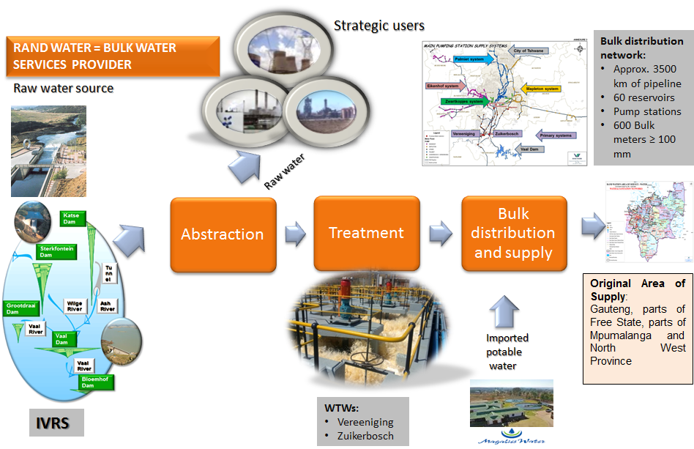
Background

Slide 3
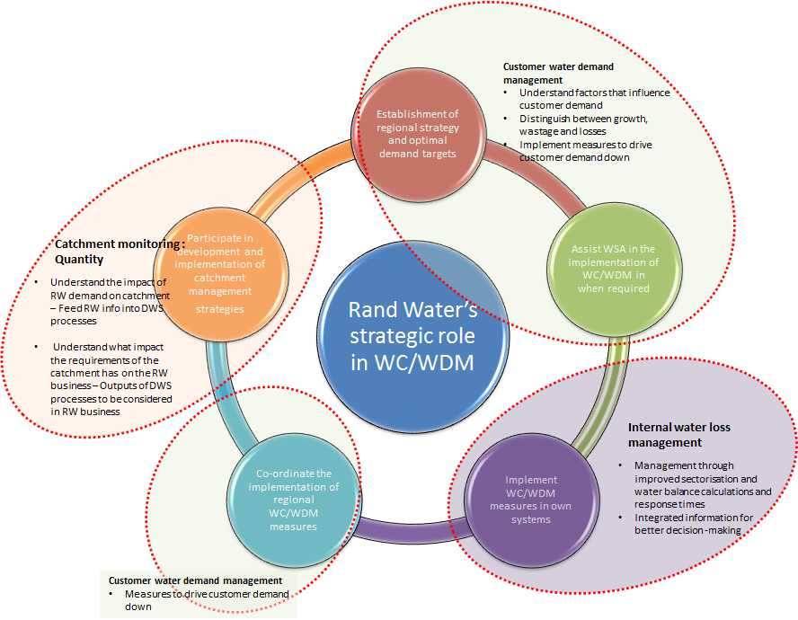
Background
NATIONAL STRATEGY FOR WATER CONSERVATION AND WATER DEMAND MANAGEMENT

Slide 4
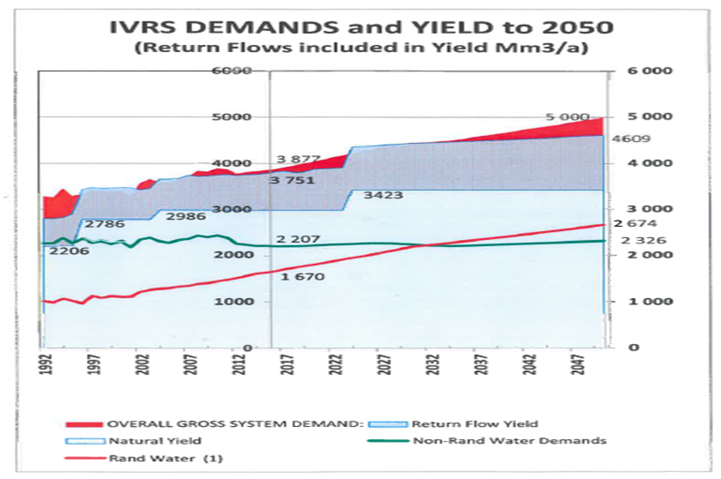
Background

Slide 5
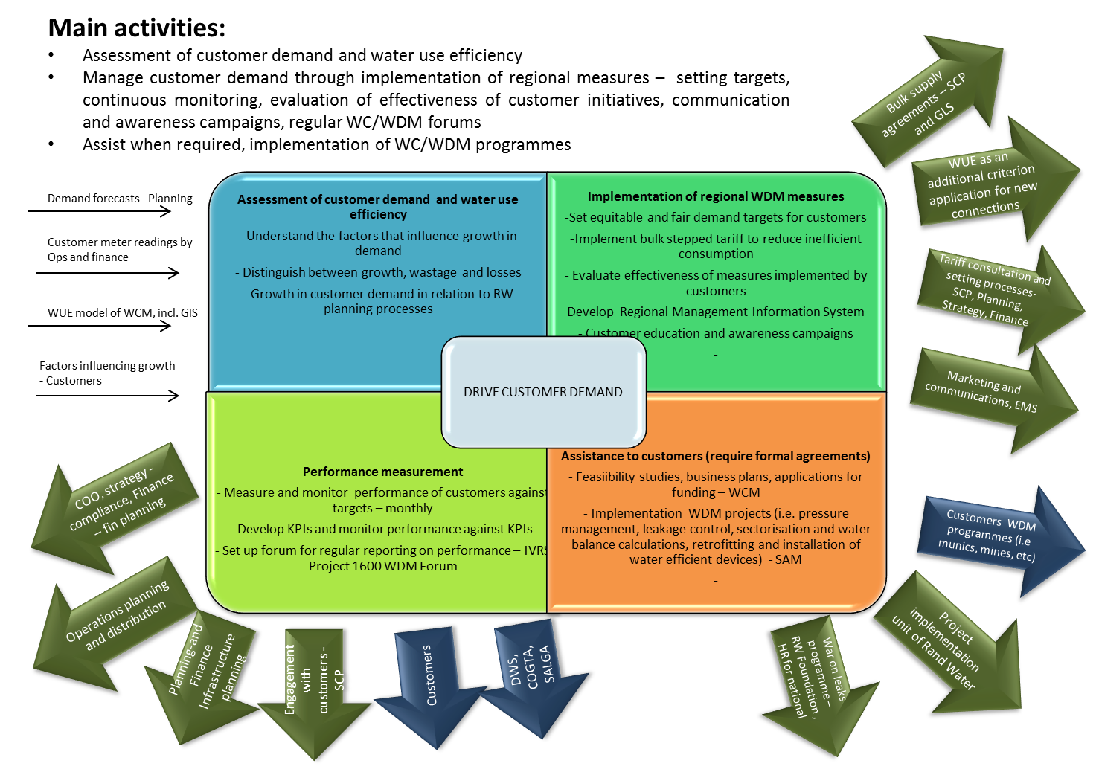
RW approach to managing customer demand

Slide 6
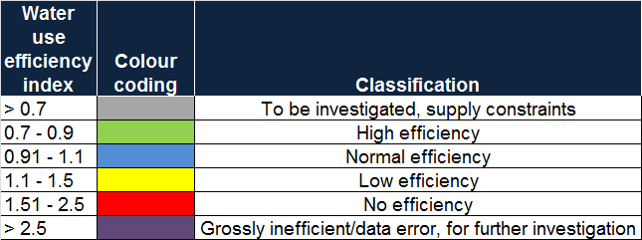
Assessment of water use efficiency
  Water use efficiency model developed by Rand Water
  Based on the scientific determination of a normal/expected demand and comparison with actual consumption
  Developed 300 categories and assigned a normal consumption to each
  Ratio of current/actual consumption to normal demand is defined as water use efficiency index (WUEI) and colour graded as follows:

Slide 7
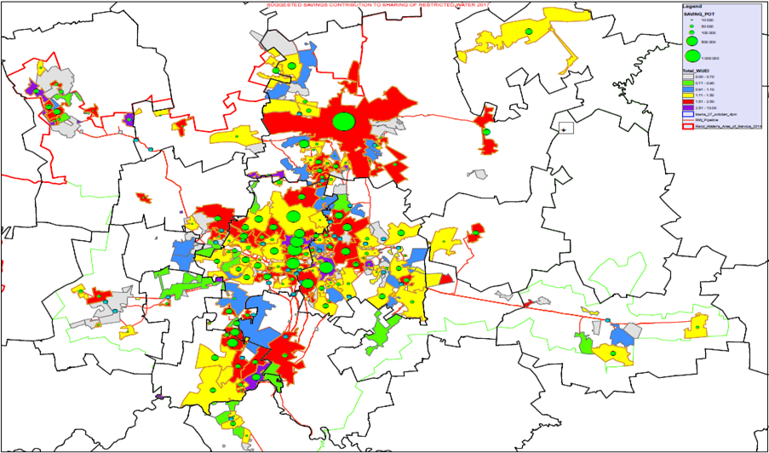
Assessment of water use efficiency
WUEI on bulk meter level in 2016 (incl. residential and non-residential): WUEI=1.38

Slide 8
End consumer consumption patterns
Minimum Night Flow (MNF) analysis
MNF analysis is a common method used to evaluate water losses in a water network.
The ratio of MNF to average daily flow is often used as a rough indicator of leakage levels.
A target value of around 20% would normally be considered in the industry as acceptable

Slide 9
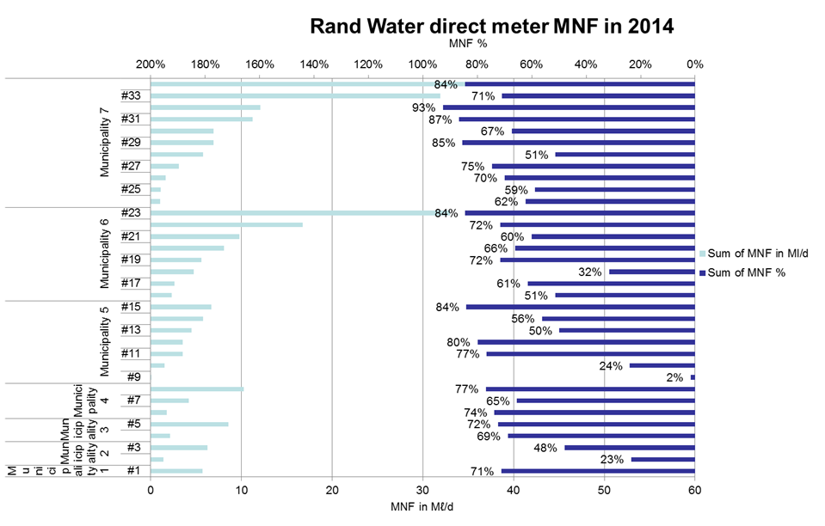
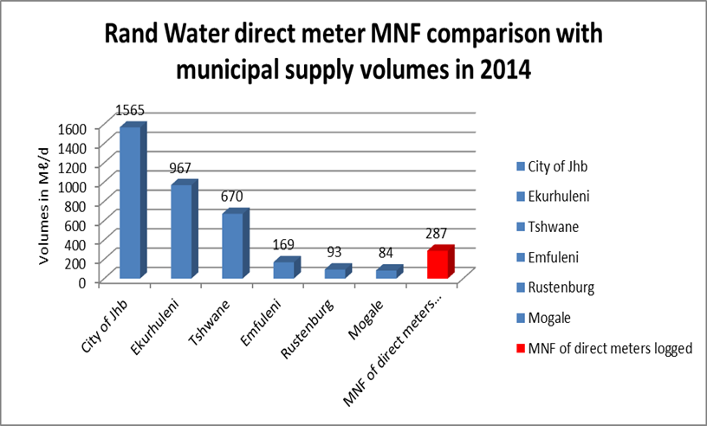
Analysis of MNF on RW direct meters
*Losses are predominantly on the end-consumer property

Slide 10
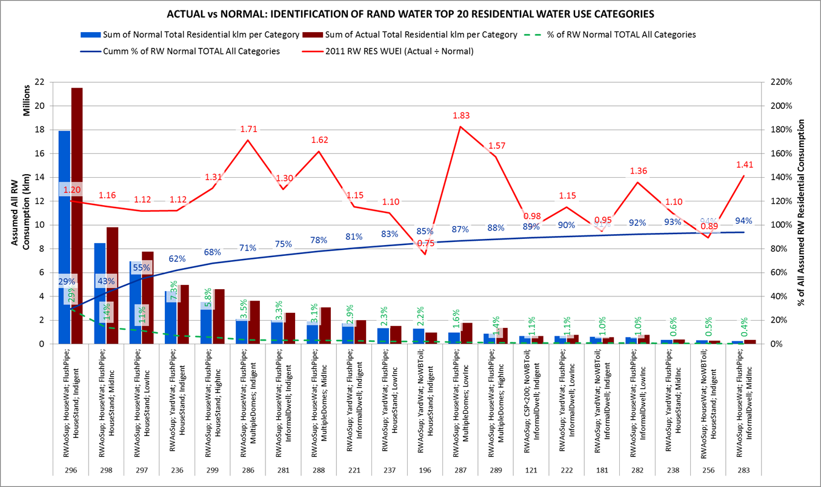
Further analysis

Slide 11
Appropriate interventions
Based on the assessments:
Need to re-align water demand management programmes and prioritize interventions that target the on-property leakages of end-consumers:
  Retroffiting of plumbing fittings at houses
  Installation of water efficient devices
  Water wise gardening practices
The importance of the war-on-leaks type projects implemented at households should not be underestimated

Slide 12
Key initiative by RW and customers:
Project 1600
Established a regional forum (IVRS Project 1600 WDM) with DWS, Municipalities, COGTA and SALGA- quarterly meetings:
Aims to provide guidance, support, oversight of progress made by municipal sector to reduce their water demand in order for Rand Water to comply with the abstraction limit of 1600 Mm³/annum until next phase of Lesotho Highlands Scheme
Municipalities were given supply targets per bulk meter based on efficiency model in September 2017
Measuring the performance of municipalities against their respective license target on a monthly basis - spreadsheets are sent to municipalities during the 2nd week of new month
Included general observations column since December 2017
Reporting at the IVRS Project 1600 WDM Committee on a quarterly basis
Requested municipalities to provide action plans for meters that exceed the license target (3 metros, Govan Mbeki and Mogale City presented action plans at meeting in Dec 2017)
Next meeting scheduled for 15 March 2018
Date of meeting | Main purpose
17 May 2017 | Introduction of Project 1600 and ToR
13 September 2017 | Adoption of ToR and Determination of targets, performance measurement
7 December 2017 | Performance update and presentation of municipal action plans

Slide 13
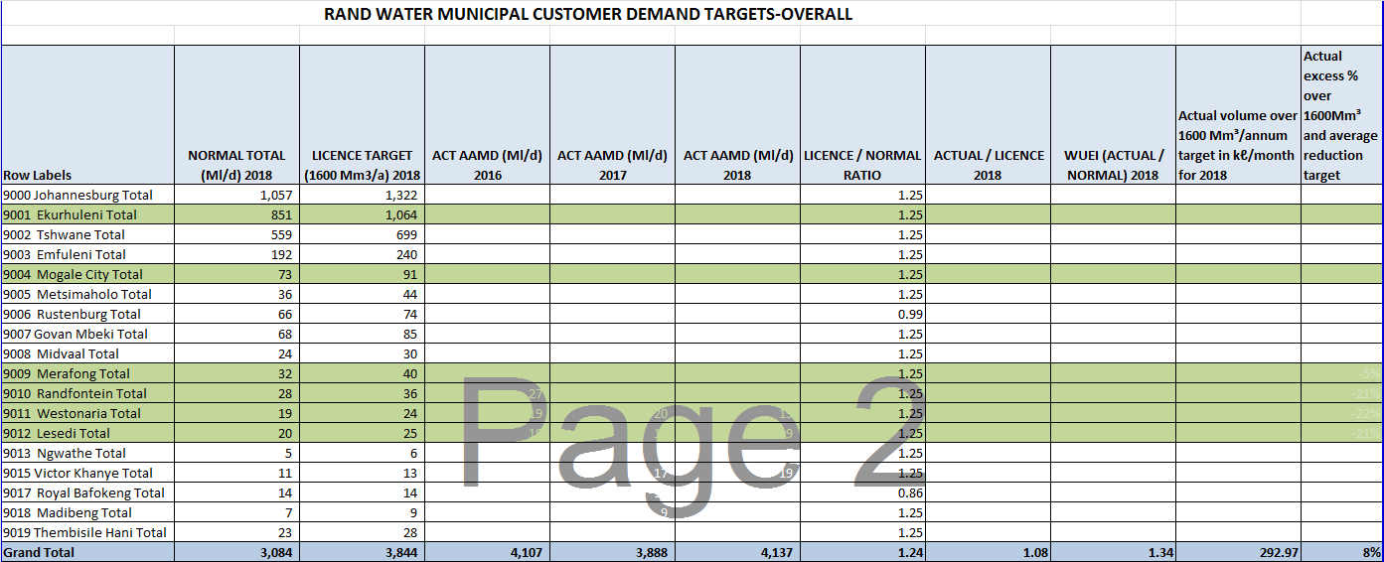
Determination of supply targets

Slide 14
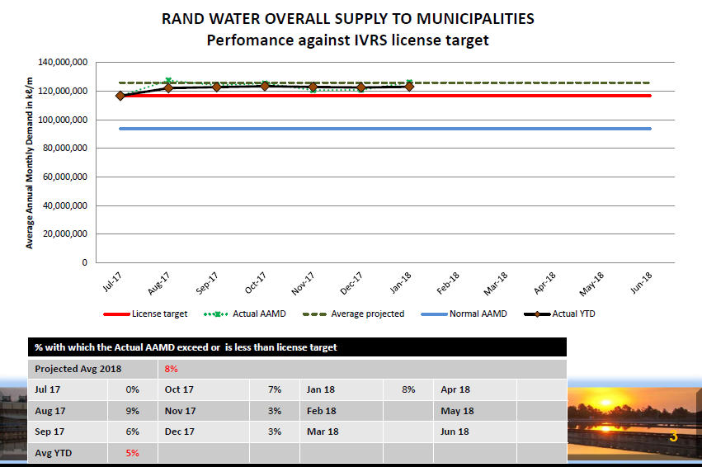
Performance of municipalities against license target

Slide 15
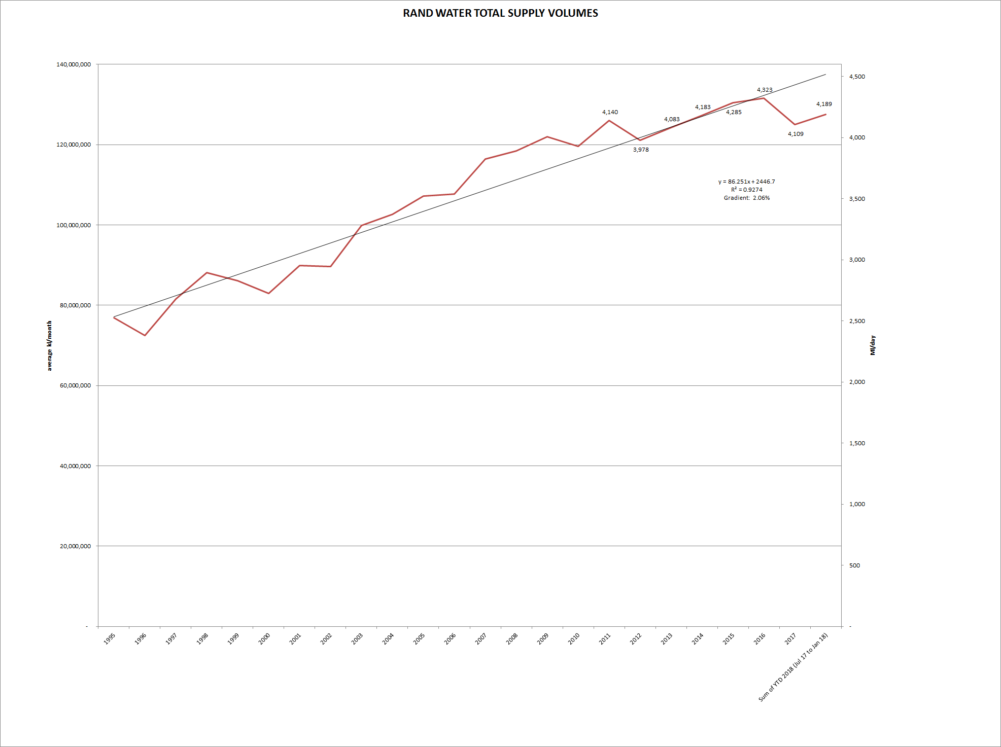
Results

Slide 16
Results

Slide 17
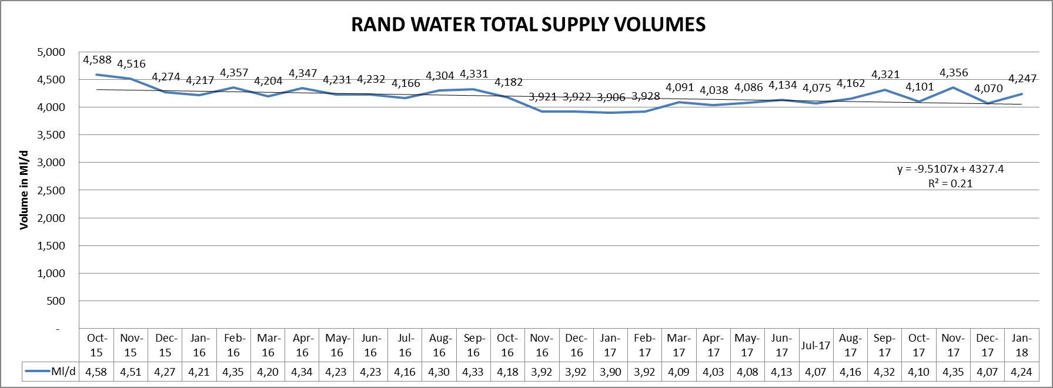
Results

Slide 18
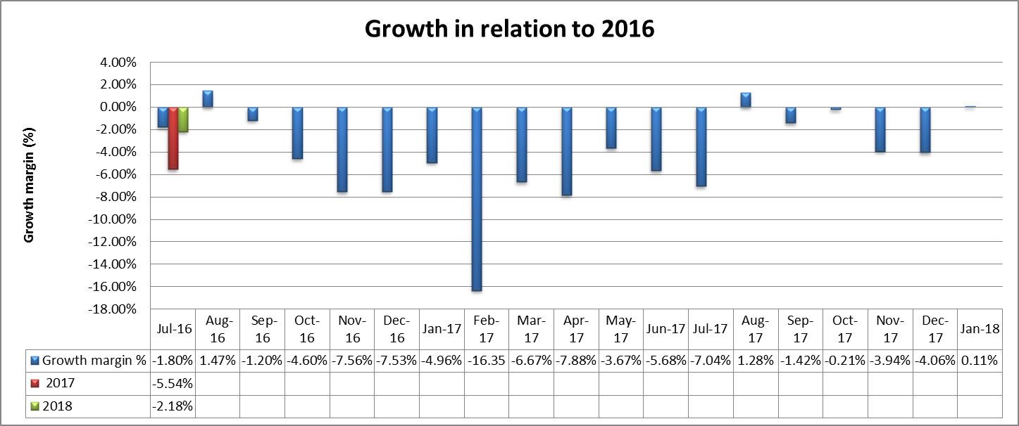
Results

Slide 19
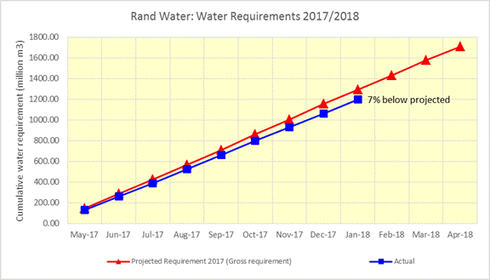
Result
Projected demand
Current demand

Slide 20
Reduction in demand
Factors influencing the reduction of Rand Water’s demand from IVRS - Reduction in demand from Rand Water’s customers
  Weather – need to determine and separate effect of weather in comparison to human intervention (lower temperatures in latter part and higher rainfall)
  Restrictions imposed since August 2016 to March 2017- measures included physical rationing of bulk meters, performance measurement on weekly basis
  Some restrictions measures remained in place (munics reported that where the measures did not adversely affect sustainable supply, these were kept in place)
  Project 1600 - Rand Water provided bulk meter targets, monitoring on a monthly basis and meeting quarterly
  Some munics communicated that their lower levels of restrictions remained in place – specifically the Metros
  End-consumer behaviour still affected by the restrictions that were implemented
  Credit control measures were implemented by Rand Water on the supply to the relevant municipalities

Slide 21
Development and implementation of regional WC/WDM measures
WDM initiatives that are being explored on a bulk supply level:
  Applications for new connections – Include water use efficiency as an additional criterion – discussion at the next Project 1600 committee meeting in March 2018
  Development of bulk stepped tariff aimed at penalizing inefficient water use
  Review of bulk supply agreements – e.g. to include steps to be taken by Rand Water in the event that the customers consumption exceeds their respective license targets
  Development and implementation of a Regional Management Information System

Slide 22
Conclusion
  Reduction in demand from IVRS is noted
  The sustainability of the reductions needs to be assessed
  Rand Water to review the impact of current status on its projected demands for the Annual Operating Analysis of DWS, scheduled for May 2018

Slide 23
THANK YOU

